Slide 1

DEPARTMENT OF ELECTRONICS AND COMMUNICATION
MINI PROJECT
TRAFFIC SIGN AUTO ASSISTANT.
SL.NO | NAME | USN | ROLL NO.
1 | Nandeesh . Katakol | 02FE22BEC040 | 40
2 | Priyanshu . Porwal | 02FE22BEC056 | 54
3 | Priyanka . Budihal | 02FE22BEC054 | 52
4 | Jamuna . Pulapatli | 02FE23BEC032 | 32
Under the Guidance of
Prof. Shridhar Iyer

Slide 2
INDEX
SL.N0 | Content | Slide No.
1 | Problem Statement | 3
2 | Need Statement | 3
3 | Literature Survey | 4-6
4 | Objectives | 7
5 | Multiple Solution | 8
6 | Methodology | 9
7 | Work Breakdown Structure | 10
8 | Input Specification | 11
9 | Output Specification | 12
10 | Detailed Block Diagram | 13
11 | Bill of Material | 14
12 | Result | 15
13 | Conclusion | 16

Slide 3
Problem Statement:
We aim to design a smart system that can detect and interpret road signs in real-time and convert detected text into voice alerts using a compact machine learning model. This system is optimized for portable devices, allowing it to operate independently on small, low-power hard- ware without requiring extensive computational resources.
Need Statement:
Develop a Road Sign Detection and Voice Alert Model for Enhanced Driver Awareness using Real-Time Image Processing.

Slide 4
Literature Survey:
Sl.NO | Paper name | Objectives | Techniques | Advantages | Limitations
1. | Deep Neural Networks for Real-Time Road Sign Detection | Real-time road sign detection adaptable to large-scale road networks | - Utilizes CNNs to extract robust features; tested on German Traffic Sign Benchmark | High accuracy, adaptable to diverse environments | High computational demand, less suitable for low-power devices
2. | Traffic Sign Recognition Based on CNN and Twin Support Vector Machine Hybrid Model | - Improve Accuracy: Develop a CNN-TWSVM hybrid model with a wavelet kernel for robust traffic sign recognition. - Enhance Generalization: Use transfer learning to reduce overfitting and improve performance. | -CNN for feature extraction, transfer learning with VGG16, TWSVM with a wavelet kernel for non-linear classification. | - Achieves high accuracy and robust performance, even on small datasets. - Reduces overfitting and improves generalization using advanced techniques like transfer learning. | The model demands high computational resources and relies on the quality of pre-trained networks and dataset diversity for optimal performance.

Slide 5
Sl.NO | Paper name | Objectives | Techniques | Advantages | Limitations
3. | Faster R-CNN Based Traffic Sign Detection and Classification | Develop a Faster R-CNN model with ResNet-50 and FPN for accurate traffic sign detection and achieve high classification accuracy for real-time traffic applications. | - Faster R-CNN with ResNet-50 and Feature Pyramid Network (FPN) for traffic sign detection and classification. | Faster R-CNN provides high detection accuracy and real-time performance, surpassing other models like MobileNetV3 and RetinaNet, especially in challenging conditions. | Faster R-CNN requires significant computational resources and may struggle in scenarios with varying sign sizes or limited dataset diversity.
4. | Traffic sign recognition method based on the YOLOv3 algorithm | Enhance YOLOv3 for traffic sign recognition by integrating spatial pyramid pooling, DIoU loss, and K-means clustering to improve small target detection and accuracy in challenging conditions. | - YOLOv3 algorithm, spatial pyramid pooling (SPP), distance-IoU (DIoU) loss, K-means clustering, and multi-scale prediction for small target detection. | Enhanced small target detection, improved accuracy with feature fusion, stable bounding box regression, and strong performance in challenging conditions. | Slightly increased computational complexity and potential struggles with very dense or overlapping traffic signs.

Slide 6
Sl.NO | Paper name | Objectives | Techniques | Advantages | Limitations
5. | Enhancing Autonomous Driving Safety: A Robust Stacking Ensemble Model for Traffic Sign Detection and Recognition | Improve accuracy for distant signs and complex backgrounds in autonomous driving | - Uses an ensemble of Faster R-CNN and YOLOX-Tiny, combining feature fusion for robustness in detection under real-world conditions | High accuracy in challenging environments with robustness against background clutter | May require fine-tuning for specific signs; computationally heavy for real-time on low-resource devices

Slide 7
Objectives:
Real-time road sign detection adaptable to large-scale road networks
Reduce false positives and improve classification accuracy for traffic signs.
Improve accuracy for distant signs and complex backgrounds in autonomous driving.
Provide accurate multi-class sign detection with reduced false positive.
Improve classification accuracy while maintaining YOLOv3’ s real-time capability

Slide 8
Multiple Solution :
Raspberry pi approach: Deploying a traffic sign detection model on a Raspberry Pi is a powerful solution that allows you to leverage greater computational resources compared to microcontrollers like the ESP32 or Arduino Nano 33 BLE. But Compared to microcontrollers like the ESP32 or Arduino, the Raspberry Pi has a relatively higher power consumption.
Traffic sign detection model on an ESP32 using Edge Impulse: An excellent option because the ESP32 offers much more computational power and memory compared to the Arduino Nano 33 BLE Sense. The Edge Impulse platform simplifies the process of building, training, and deploying machine learning models on edge devices like the ESP32, making it an ideal choice for TinyML applications.
Using Intel i5, with graphics card GTX 1650: The available machine right now and powerful one with plenty of resources. Training the model on Teachable machine website to make it much affordable and suitable for the present use case.

Slide 9
Methodology:
Making the processor ready to run the model by installing necessary libraries.
Setting the Google Colab environment such that it should be able to carry the program.
Training the model on Teachable machine software provided by Google with the dataset.
Dataset Acquisition and Preprocessing.
The dataset is taken from https://github.com/hparik11/German-Traffic-Sign-Recognition/tree/master/images
Importing the model into Google Colab and ready to run .
Testing and Calibration.
Optimization and Scalability.

Slide 10
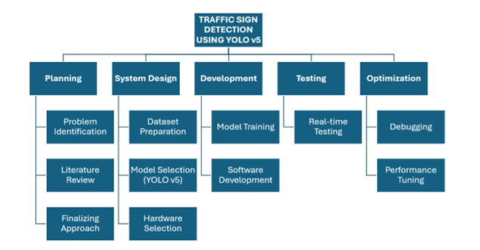
Work Breakdown structure:

Slide 11
Input specification:
Data type: Images and Video of Traffic signs.
Input Source: Public dataset, containing images and videos of road while driving.
Image Specification: lowered resolution (ex:128x128 pixels) in JPEG or PNG format. For videos. Resolution: 640x480 pixels or 1280x720 pixels (depending on resources).Frame Rate: 15-30 fps
Environment :Designed for real-world conditions.

Slide 12
Output specification:
1.Data Type: Classified traffic sign label.
2.Output Format: Text label or Voice alert.
3.Latency: Real-time predictions within few seconds.
4.Actions: Output results displayed on a Display output.

Slide 13
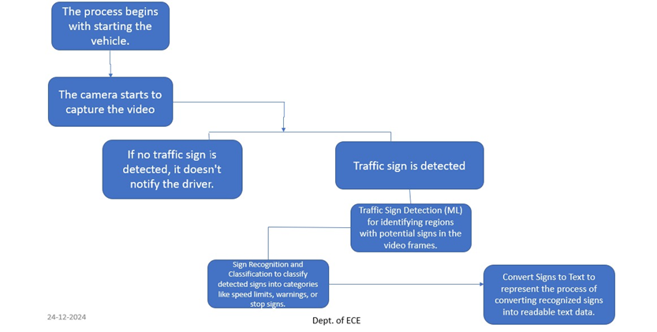
Detailed Block Diagram:

Slide 14
Bill of material:
As we are running the Machine learning algorithm on our laptop with configuration RYZEN 5000 series with NVIDIA GEFORCE GTX 1650 graphics card for our project and no hardware component is required for the project the bill of materials will be zero.

Slide 15
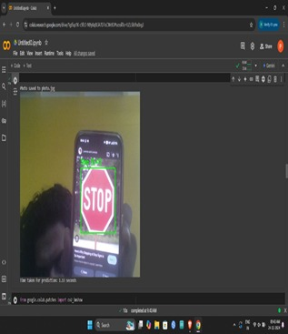
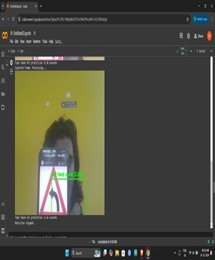
Results:

Slide 16
Conclusion :
The Traffic Rule Auto Assistance project effectively uses a laptop camera and machine learning to detect traffic signs and convert them into audio text, providing real-time guidance to drivers. This system enhances road safety and offers a practical solution for improving driver awareness. Future improvements can focus on optimizing accuracy and usability

Slide 17
THANK YOU

